Slide 1
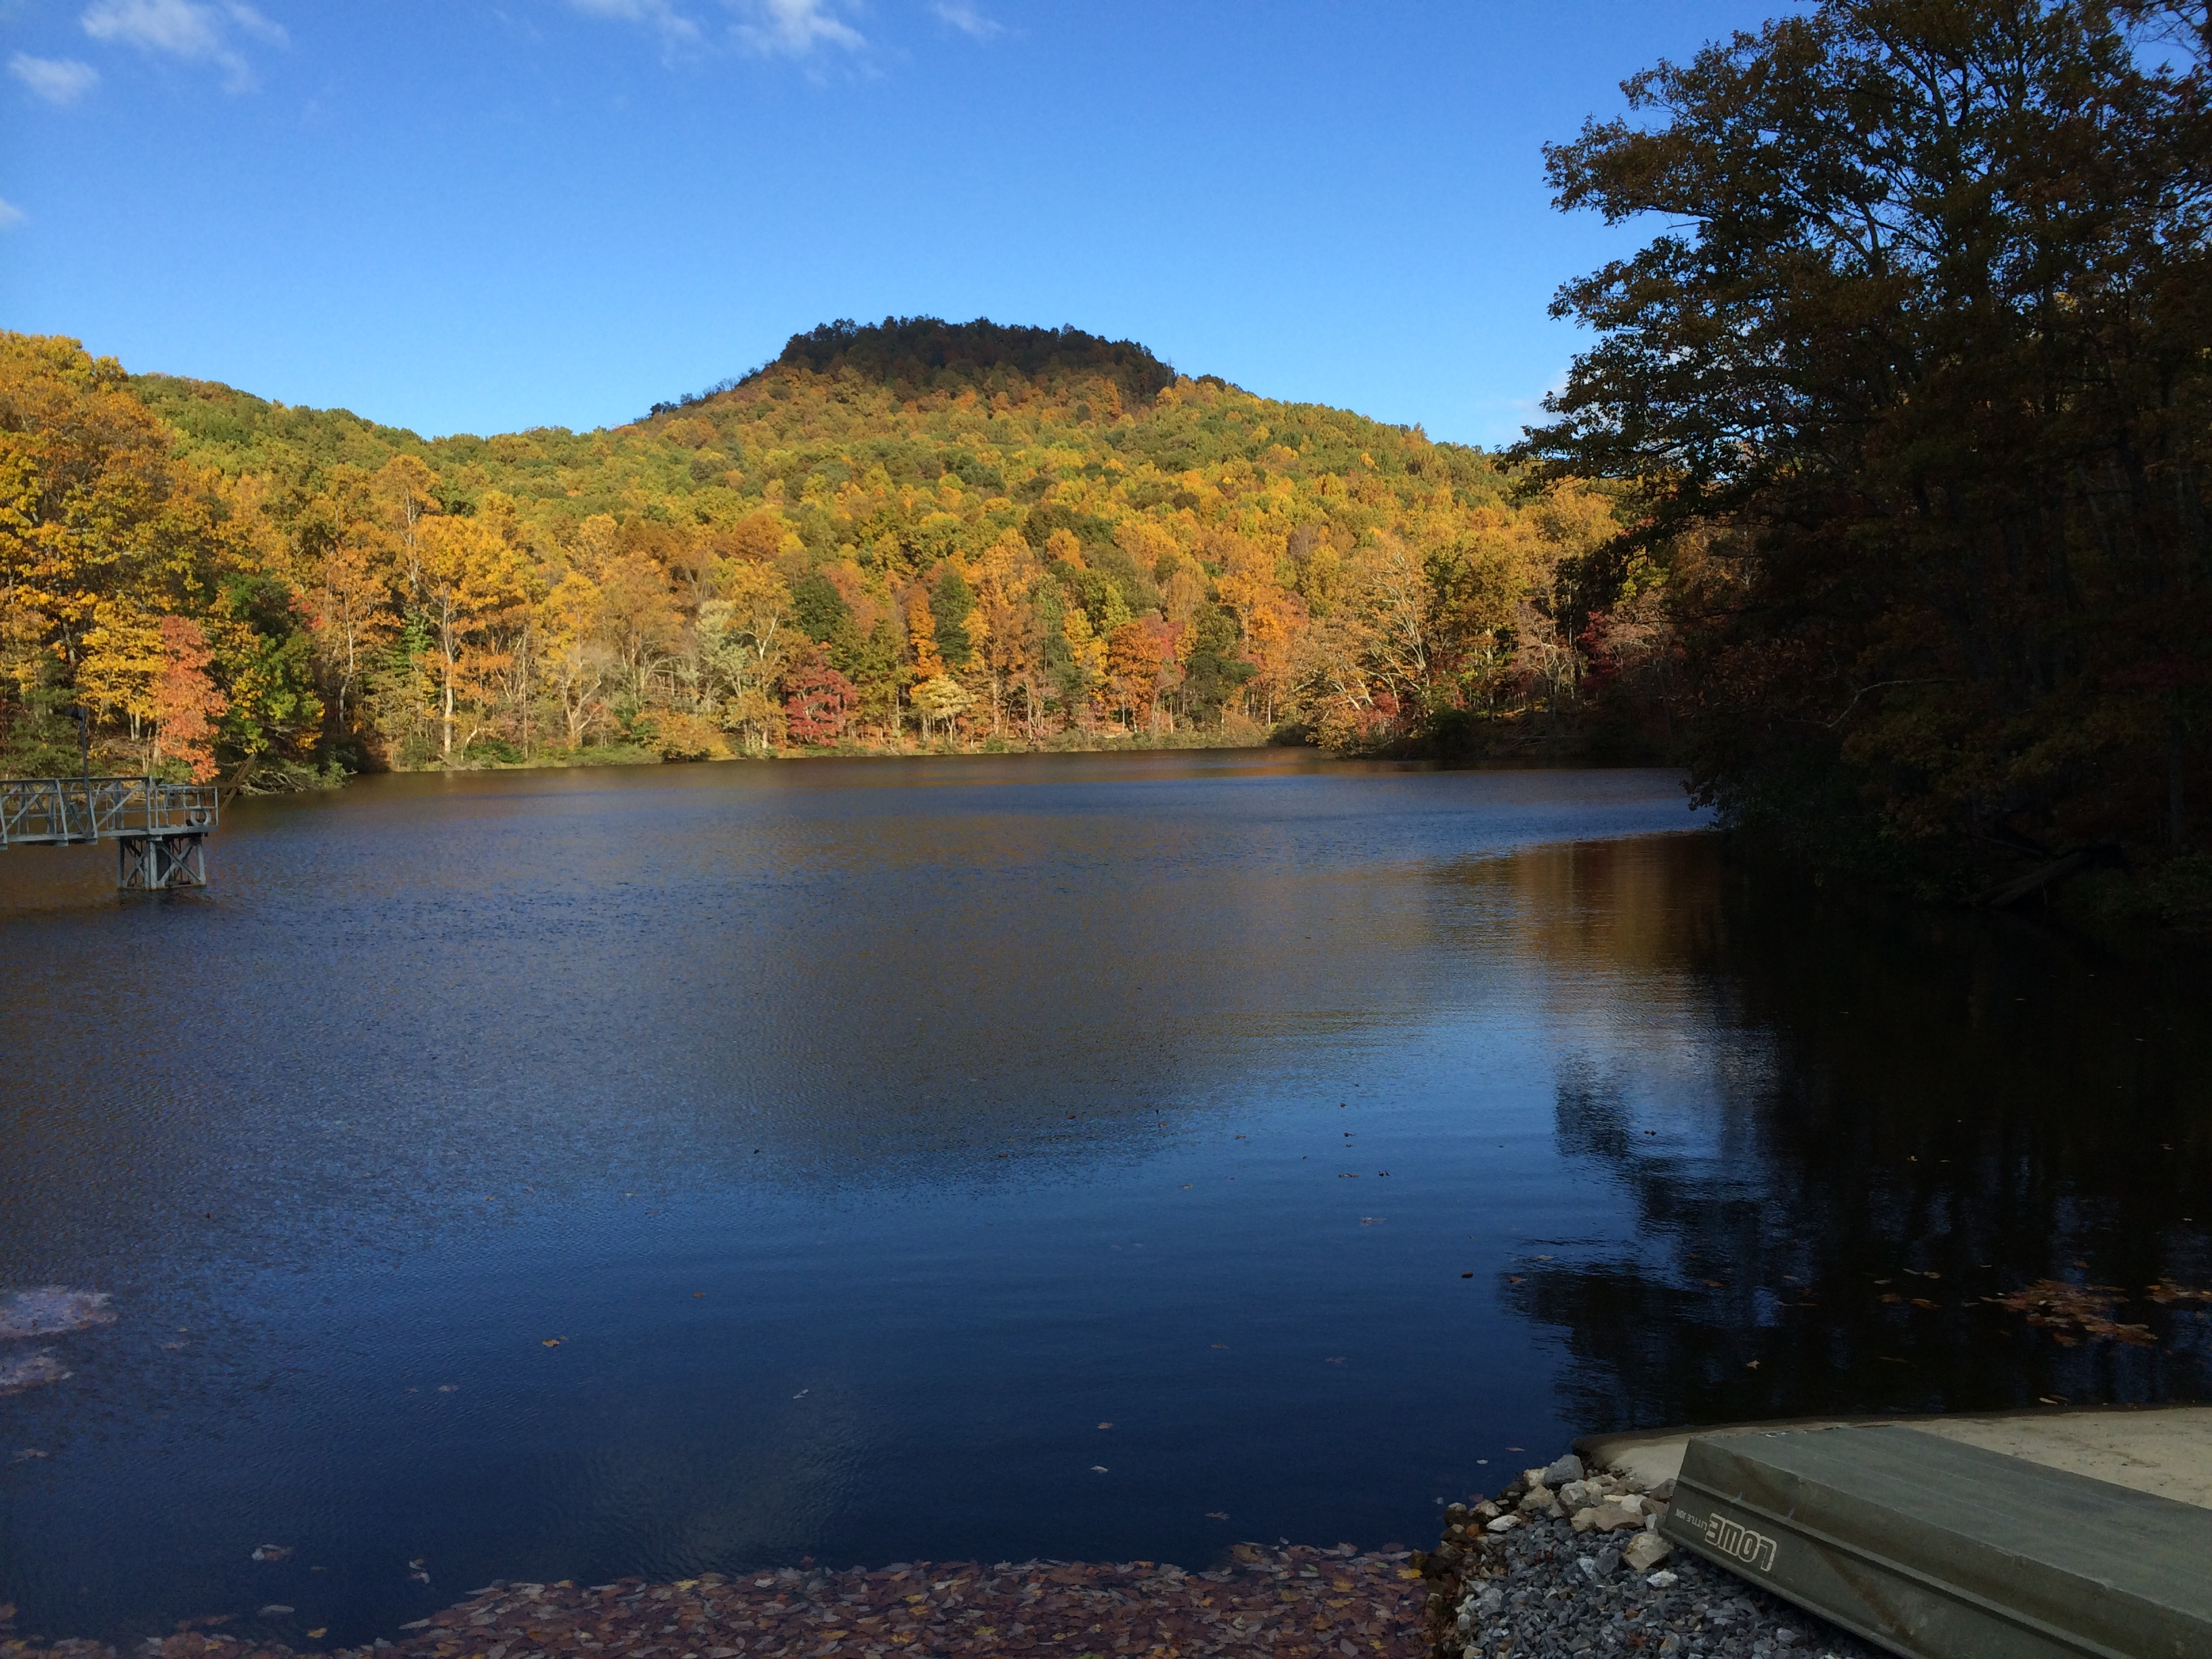
Forecasting algal blooms in Falling Creek Reservoir

Slide 2
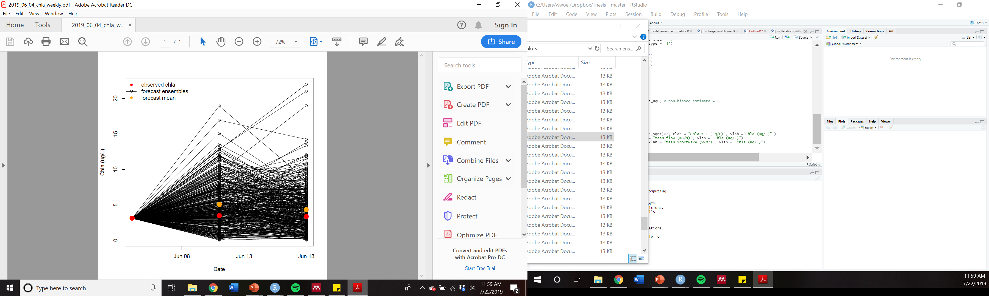
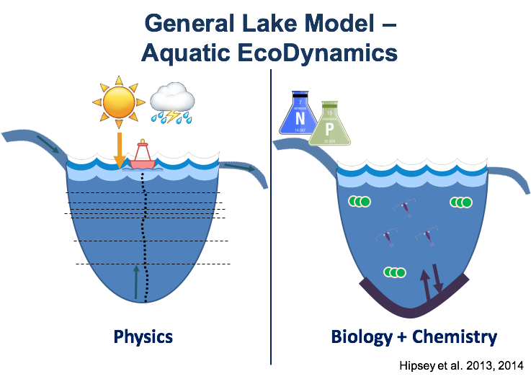


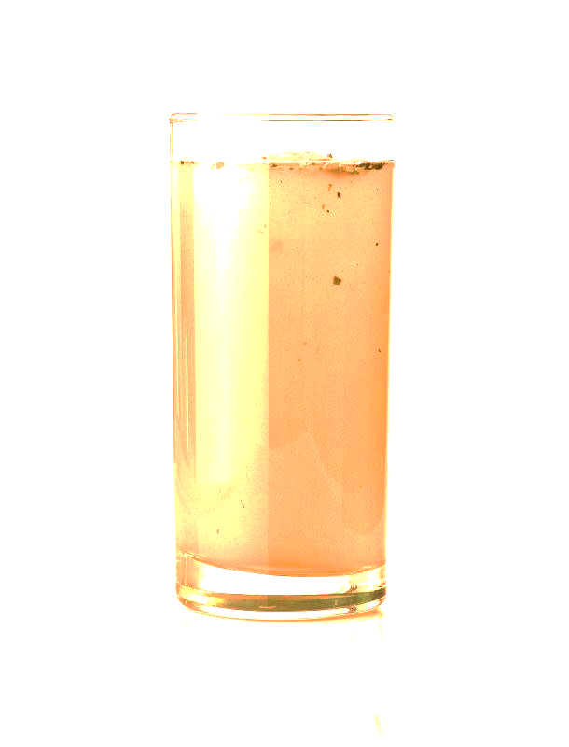


FLARE (Forecasting Lake And Reservoir Ecosystems)
Data assimilation and Forecasting Workflow
Model output: 1- and 2-week forecasts of chlorophyll-a
Real-time sensor
Input data
16-day weather forecast
Chl-a Model
Historical observational data
Forecast for managers & decision support tools
Mon
Tues
Weds
Thurs
0%
25%
75%
95%
Adaptation: R. Quinn Thomas et al.
Notes:
To summarize the workflow of one day of our forecasting system, which is called FLARE (Forecasting Lake and Reservoir Ecosystems), meteorological sensor data being recorded every minute stream to a server that make the data available on github, a data storage website. These data are used to run a lake model for one day, which generates model output that are compared with observational data and used to update the model. The updated model serves as the initial conditions for the next day’s simulation, which are fed by NOAA’s 16-day GEFS meteorological forecast, which is used as driver data to generate a water quality forecast for the next 16-days.

Slide 3
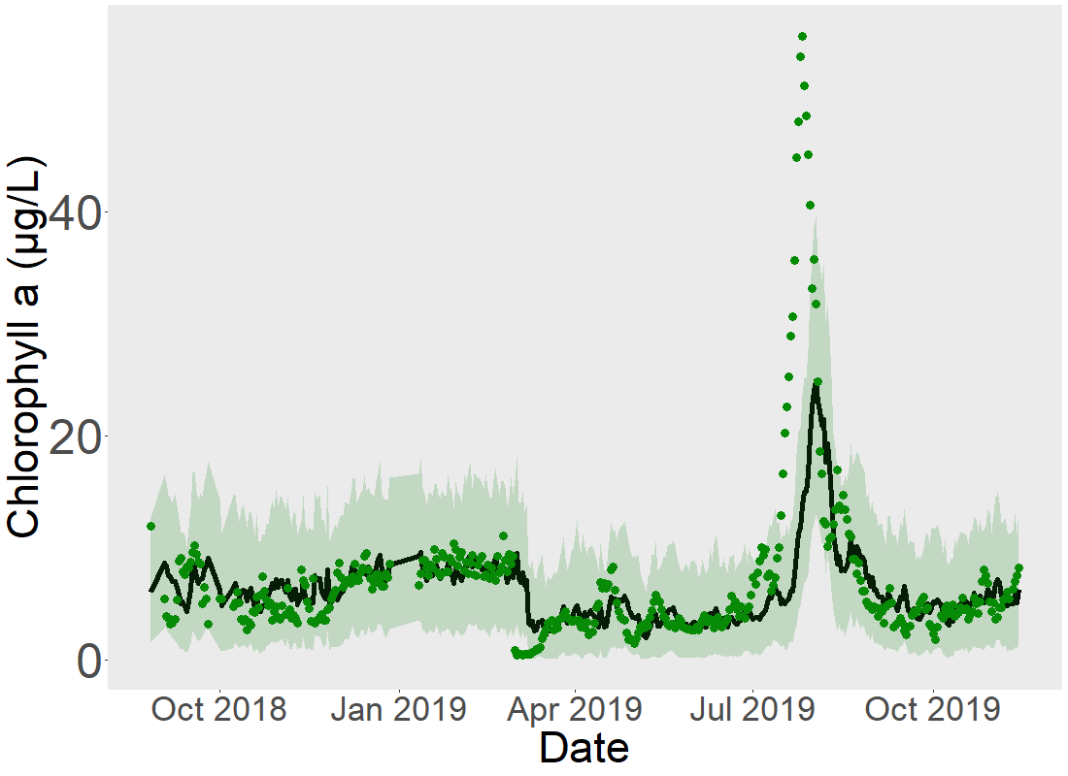
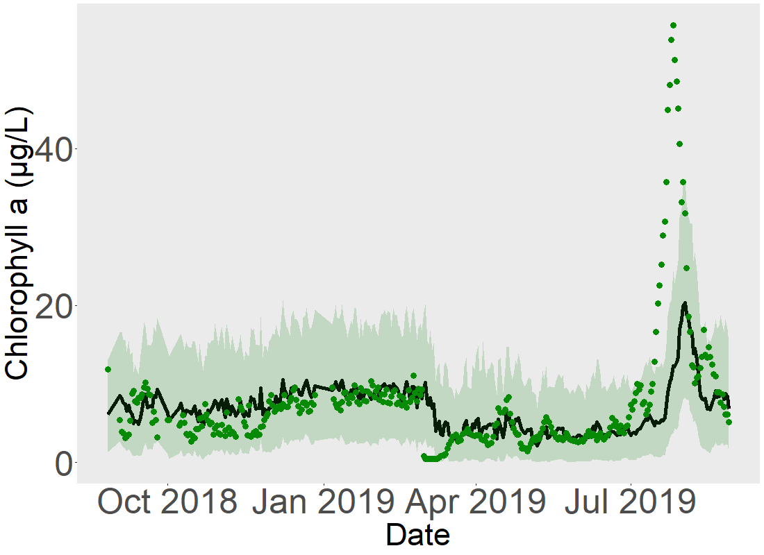
Q1: How well can we forecast near-term algal biomass (chlorophyll-a) using an empirical model approach?
Observed
Forecast mean
95% Confidence Interval
Total R² = 0.38
Total RMSE = 6.5 μg/L
Non-bloom* R² = 0.44
Non-bloom* RMSE = 1.9 μg/L
*outside dotted lines

Slide 4



What are the dominant drivers of uncertainty in our forecasts?
Initial condition uncertainty
Discharge driver uncertainty
Chl-a_{t} = β₁ + β₂Chl-a_{t-1} – β₃Discharge_{t} – β₄Shortwave_{t} + Ɛ
Process uncertainty
β_{x}
Parameter uncertainty
Meteorological driver uncertainty
21 NOAA forecast ensembles

Slide 5
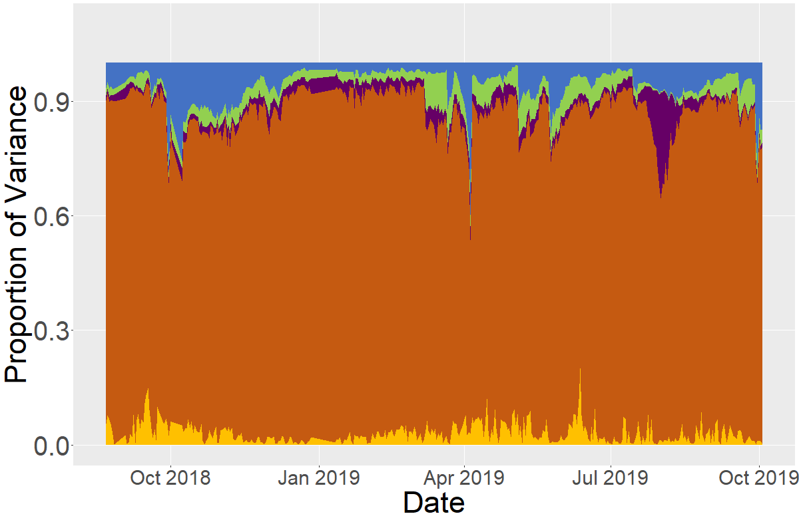
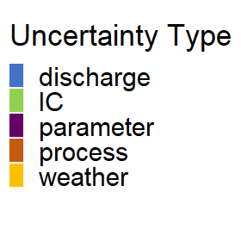
Relative proportion of uncertainty changes throughout the time series
Notes:
Add legend

Slide 6

Effectively Visualizing Forecast Output
a) All ensembles shown + forecast mean
b) Mean + CI (extrinsic)
c) Polygon of entire CI (intrinsic)
Chl-a (ug/L)
Chl-a (ug/L)
Time into future
Time into future
d) Animation of forecast mean + CI through time up to present
e) Interactive app that allows user to visualize in multiple ways

Slide 7
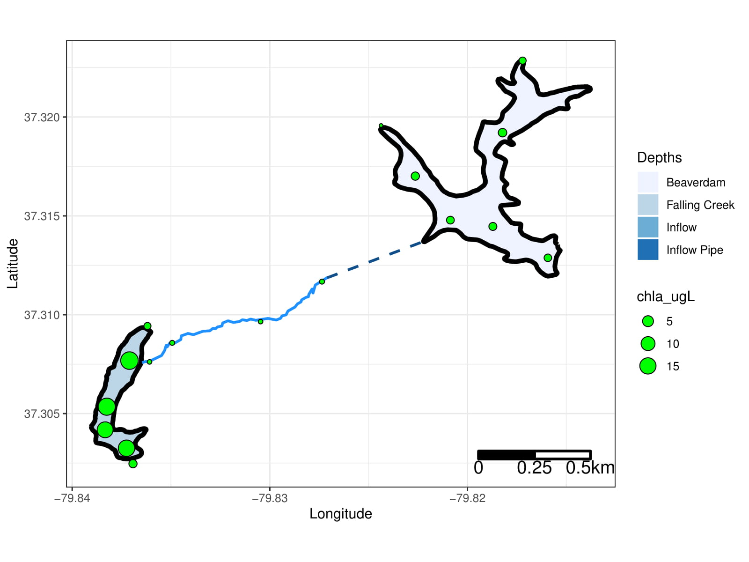
Heterogeneity among reservoir continua
Q1: What is the longitudinal heterogeneity of nitrogen, phosphorus, and chlorophyll-a along a double reservoir continuum?
Q2: What are the drivers of heterogeneity among reservoir continua (i.e., residence time, internal loading)?
2 reservoirs
5 streams
17 sites total
6 sampling days

Slide 8
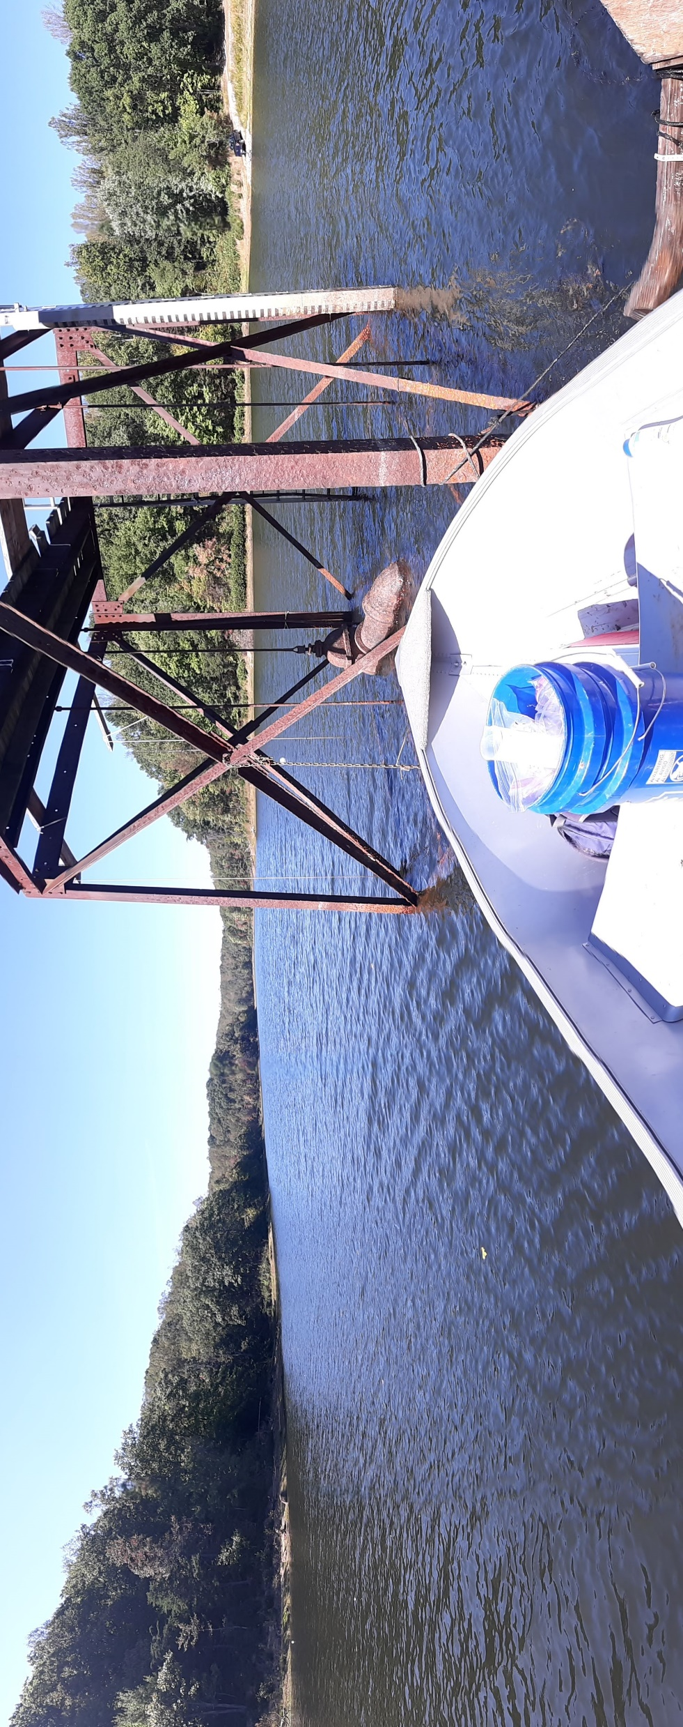
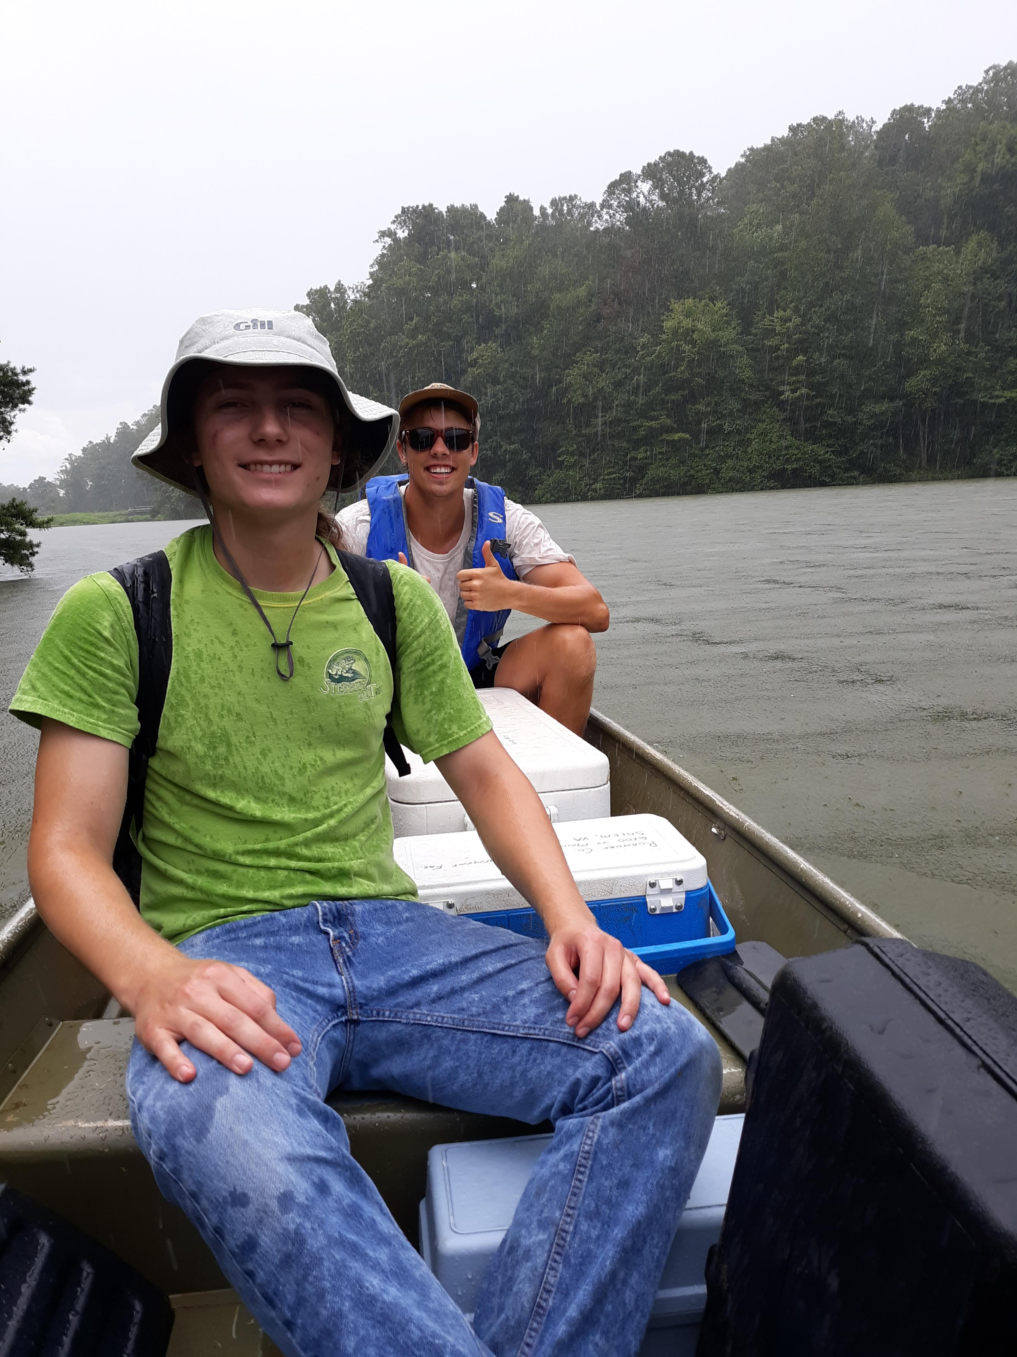
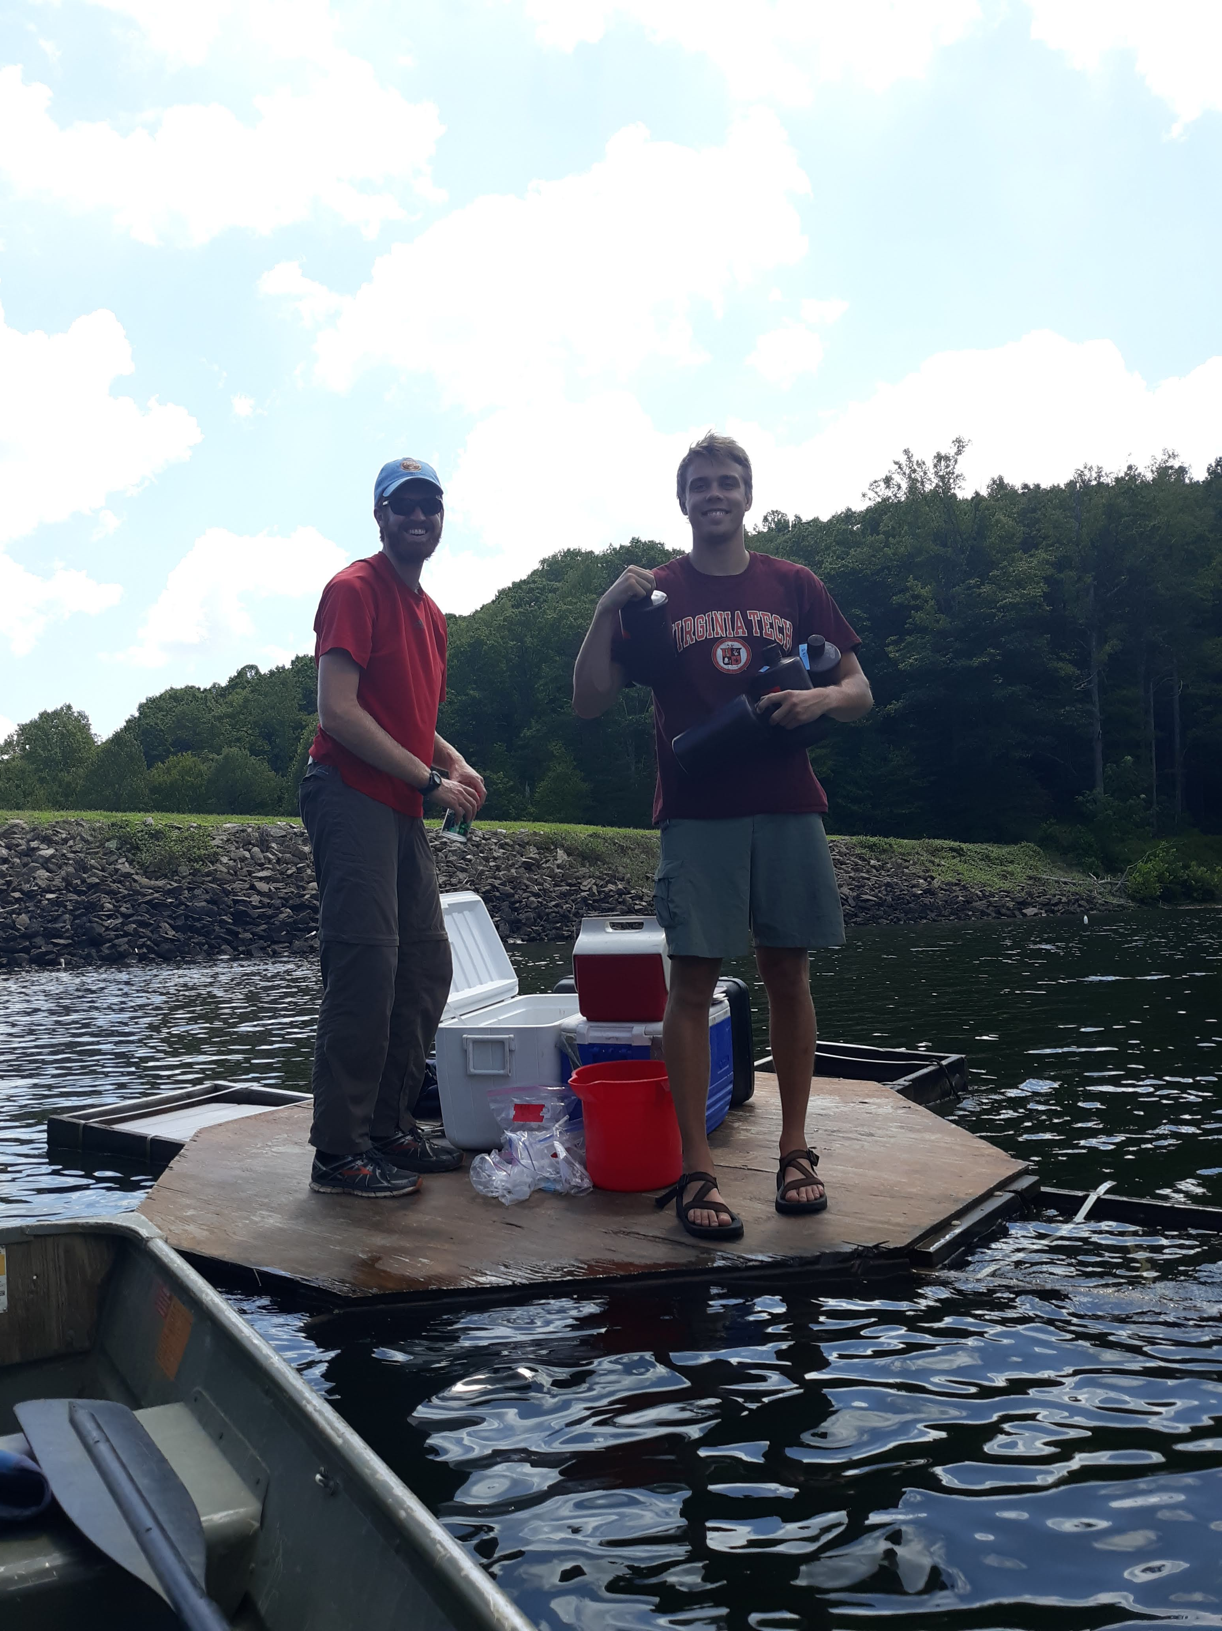
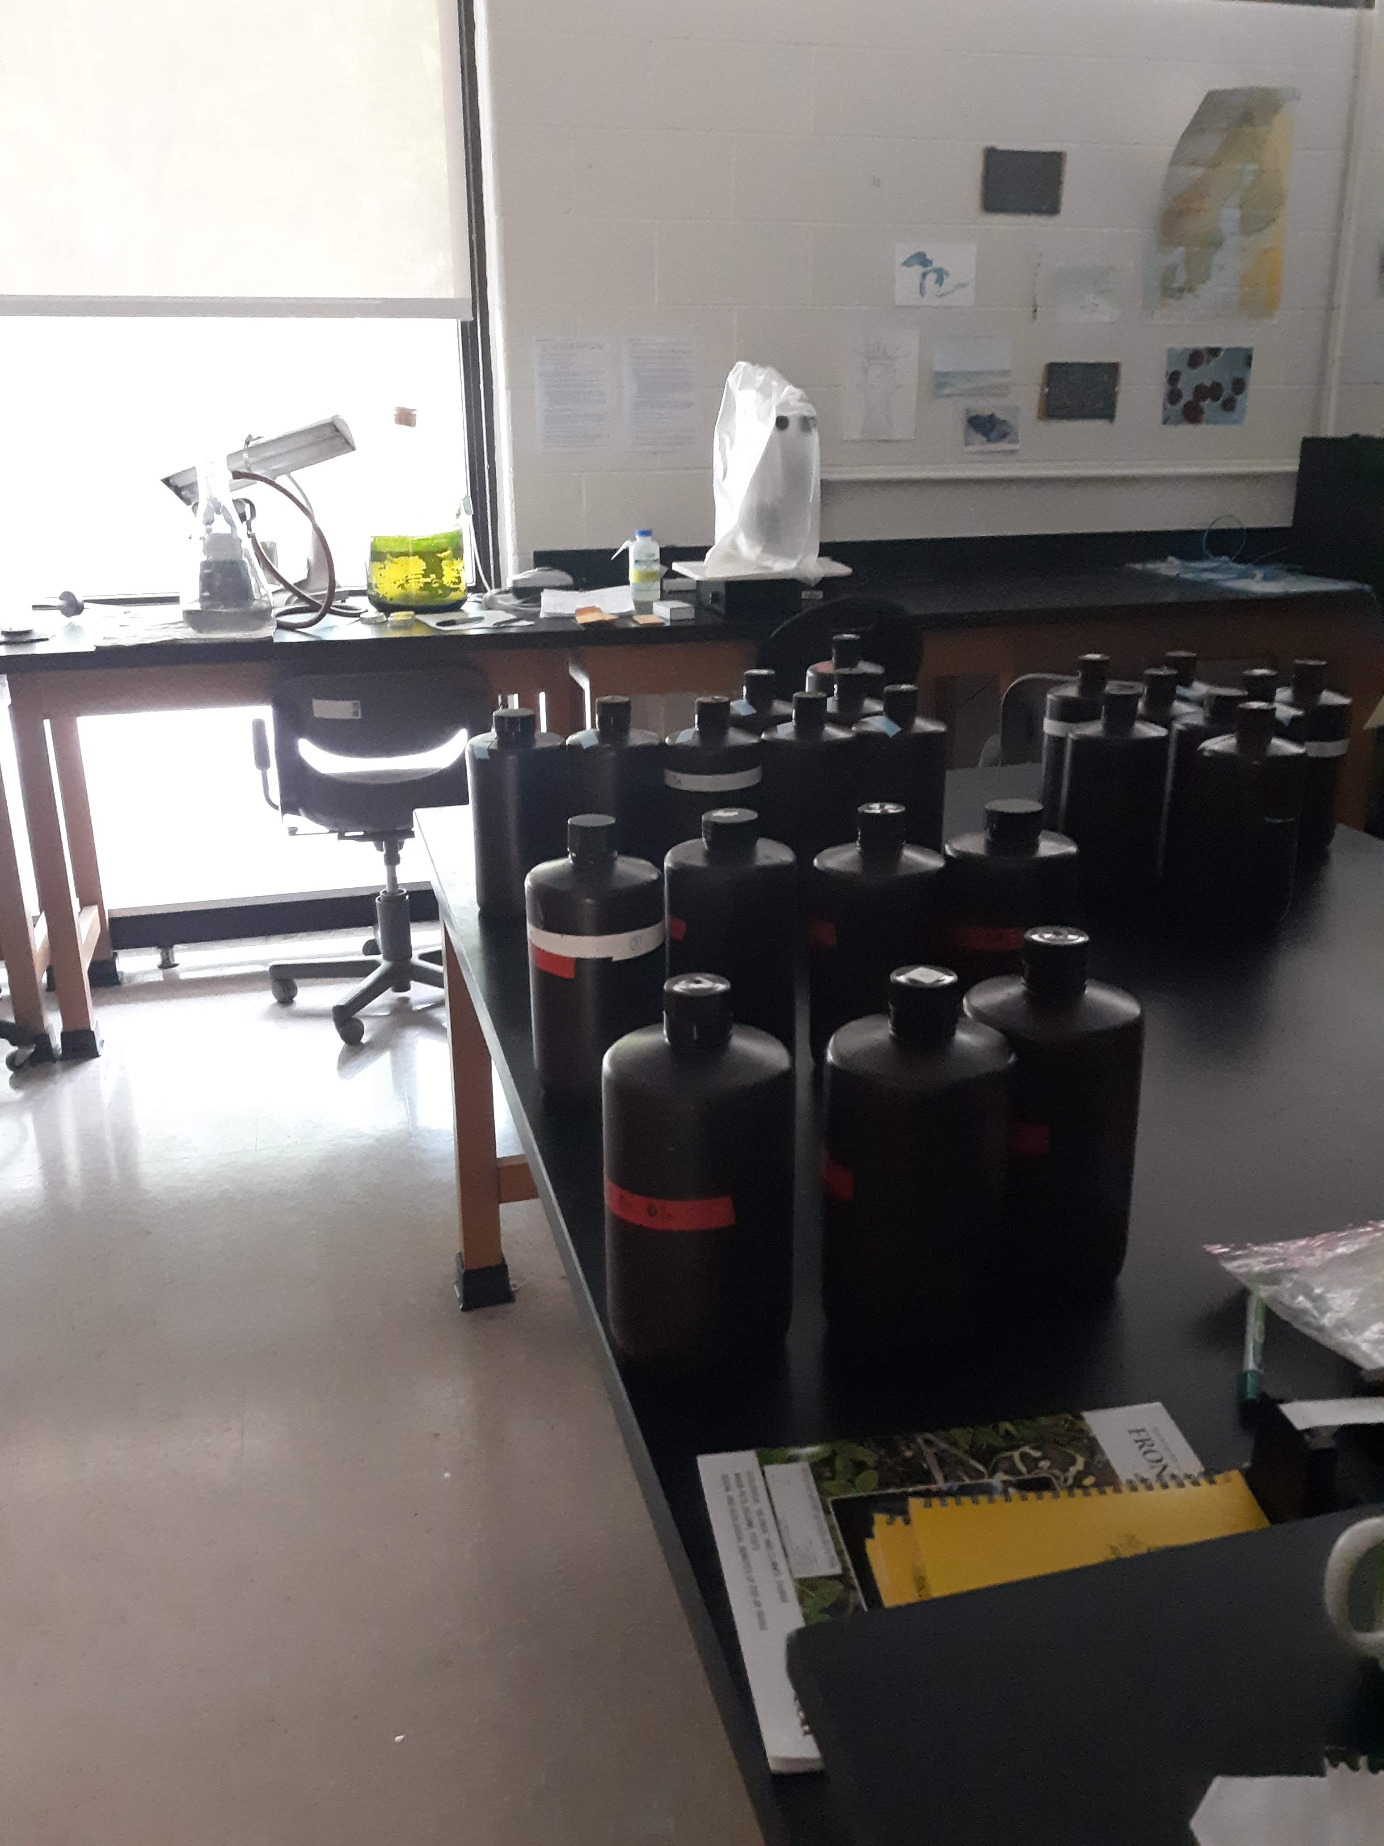
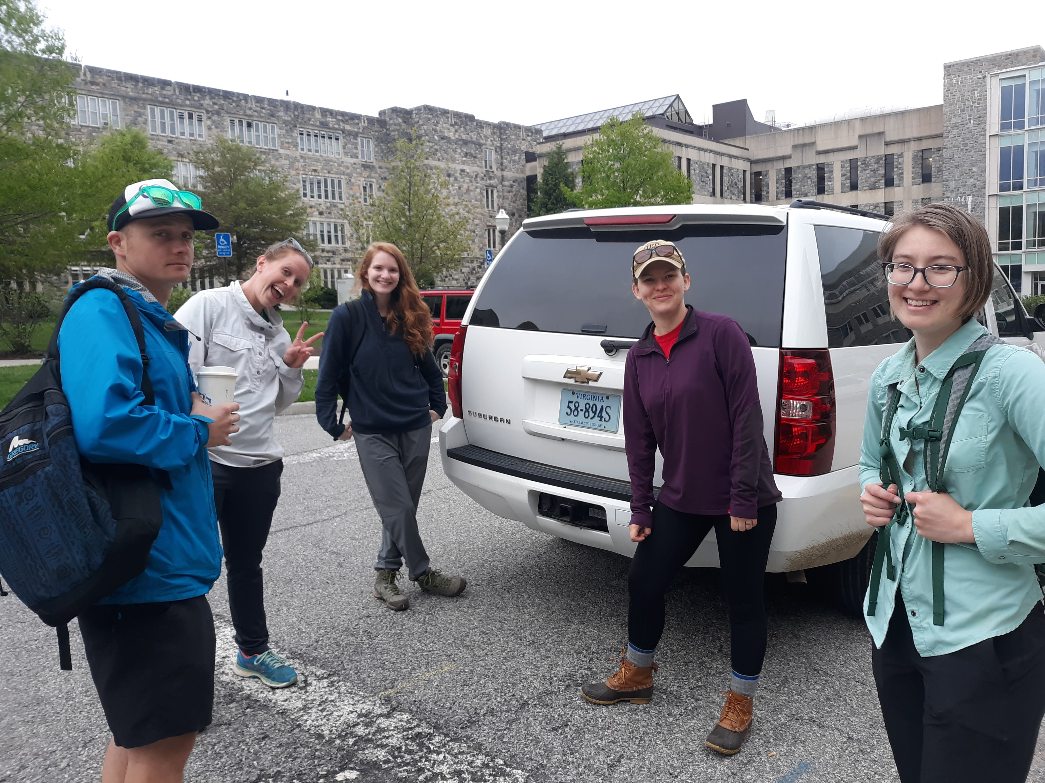
Looooots of field sampling and teamwork!

Slide 9
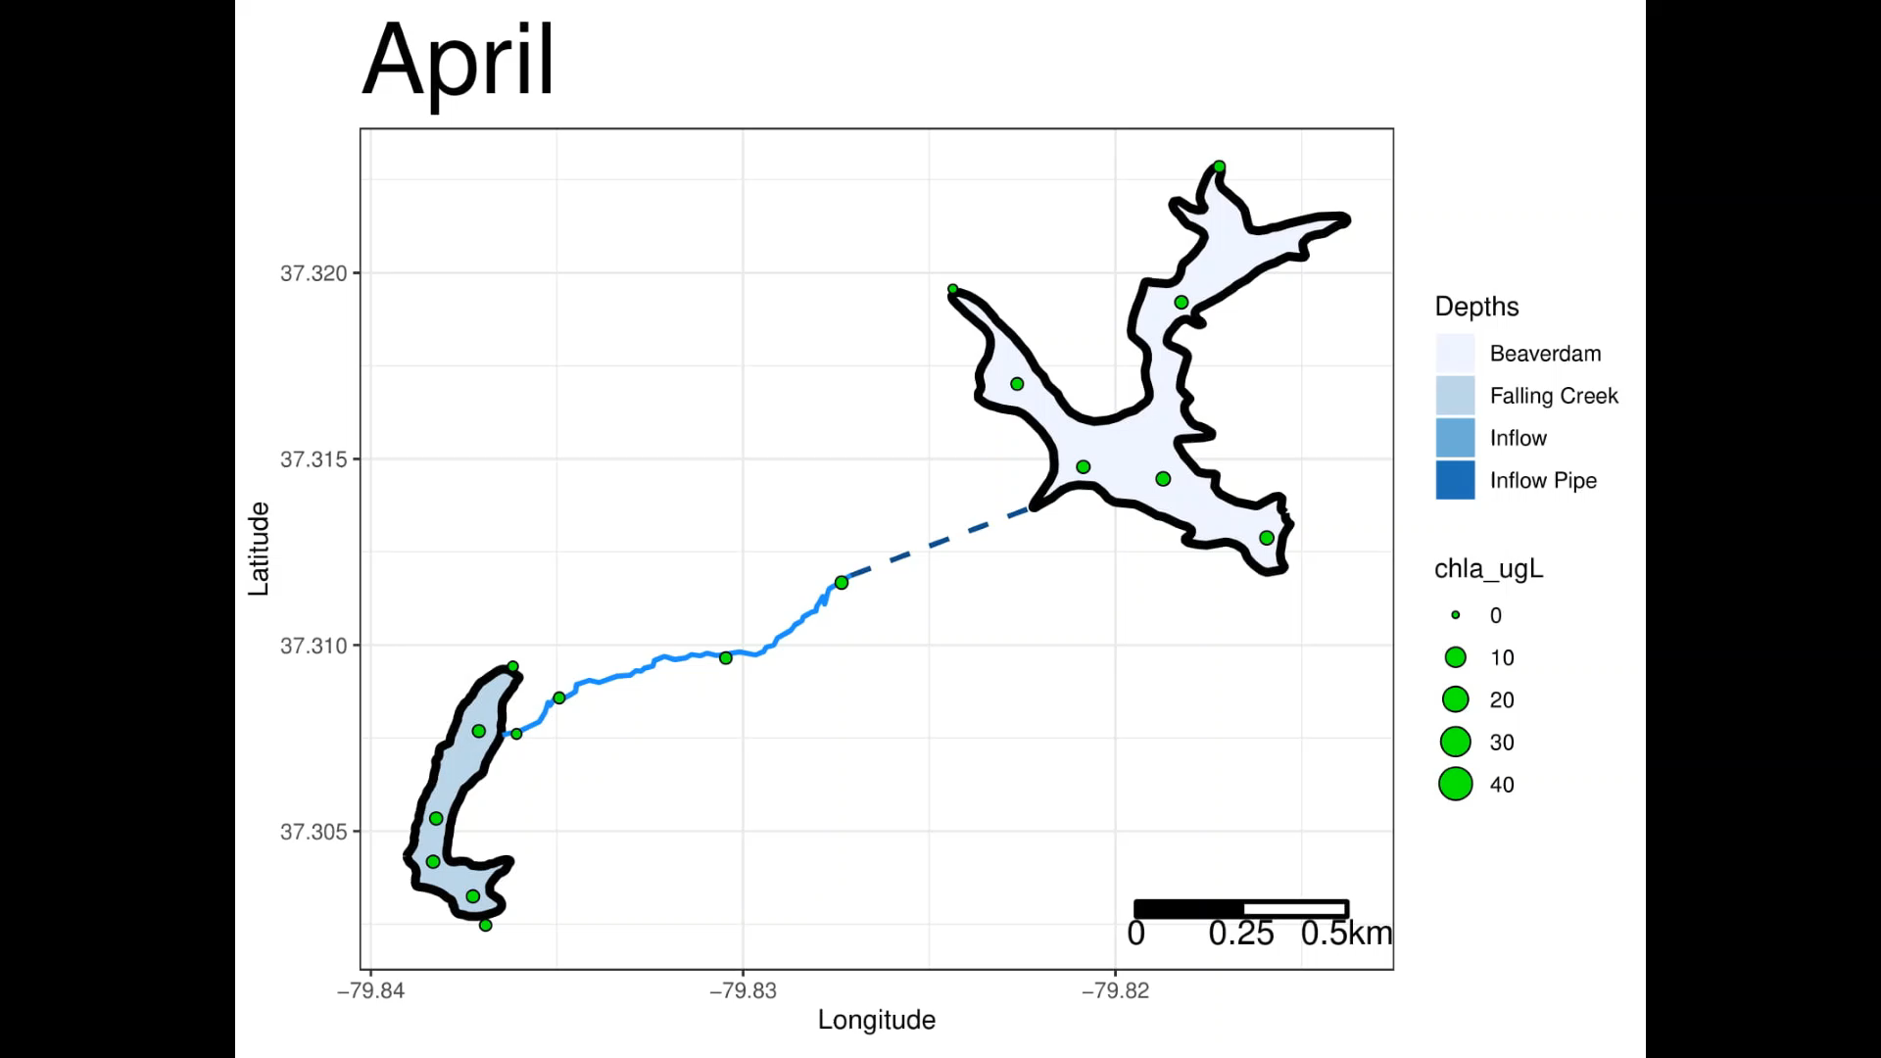
FCR and BVR exhibit seasonal trends and heterogeneity between reservoirs

Slide 10
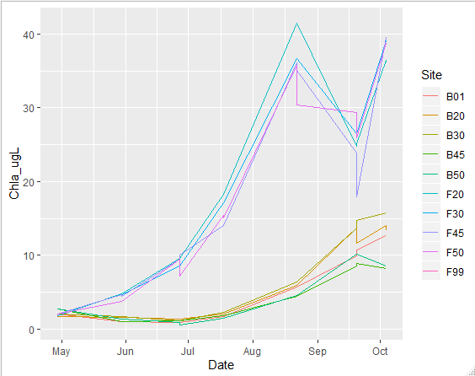
FCR and BVR exhibit similar increasing trend over time but different magnitude in amount of increase
Why?
Weather is consistent btw them
Residence time?
Working on rough water budgets
Nutrients from inflows forthcoming
FCR receiving nutrients from BVR?
Internal loading?

